Slide 1
Linear Programming
Advanced Algorithms Mark Floryan CLRS Ch. 29

Slide 2
Introduction and motivation

Slide 3
Motivating Problem
You are a politician trying to win an election. Your district contains urban, suburban, and rural areas that have 100,000, 200,000, and 50,000 residents respectively. You want to spend the least amount of money, and target your advertisements so that you can win over at least half of the people in each respective area. Your policy priorities are to build roads, increase gun control, provide farm subsidies, and add a gasoline tax.
Your policies are not all popular in all areas of your district, so how can you divide your message advertisement across the three areas to obtain votes from at least half of the people in each area?

Slide 4
Modeling the constraints
With some polling, you decide that the table to the right is a good approximation of the effect of spending money on each issue.
For each row, spending $1000 on that issue will lead to x*1000 voters moving in/out of your favor in each respective area.
Policy | Urban | Suburban | Rural
Build Roads | -2 | 5 | 3
Gun Control | 8 | 2 | -5
Farm Subsidies | 0 | 0 | 10
Gasoline Tax | 10 | 0 | -2
For example, if you spend $1000 on your gun control stance, you will gain 8000 urban voters, 2000 suburban voters, but lose 5000 rural voters

Slide 5
Modeling the constraints
Ok, so we are trying to calculate:
x₁: Money spent on build roads x₂: Money spent on gun control x₃: Money spent on farm subsidies x₄: Money spent on gas tax
Subject to: We want to win half the voters in each area (see next slide for formulas)
Policy | Urban | Suburban | Rural
Build Roads | -2 | 5 | 3
Gun Control | 8 | 2 | -5
Farm Subsidies | 0 | 0 | 10
Gasoline Tax | 10 | 0 | -2

Slide 6
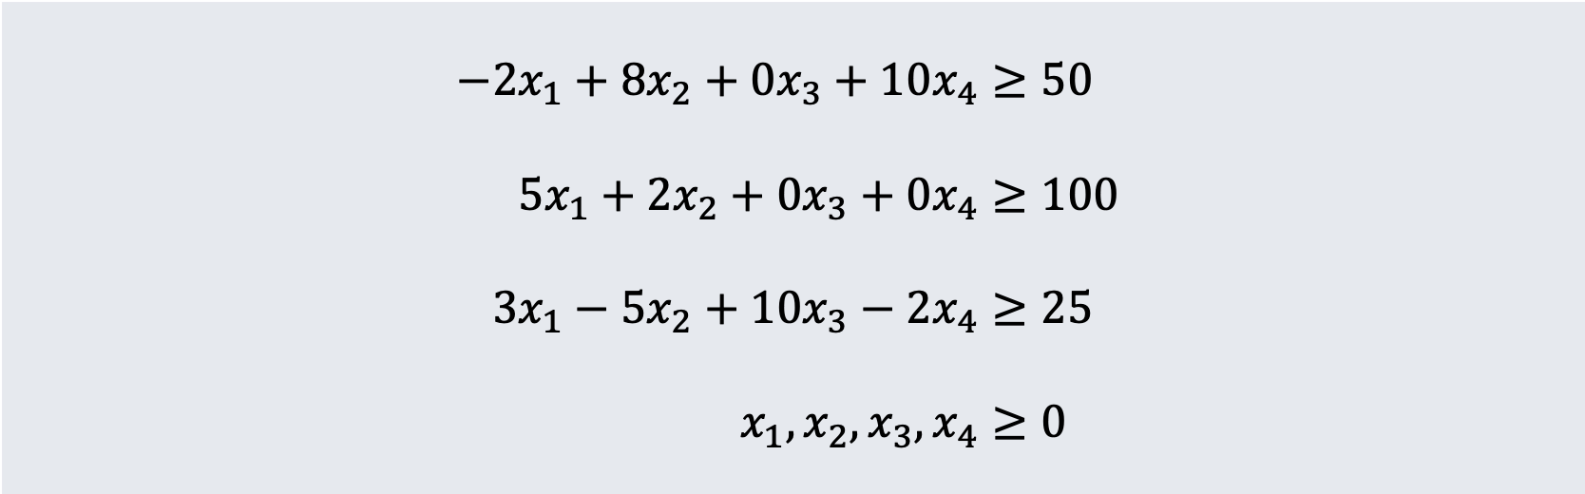
Final Linear Program
We want to minimize total cost on advertising:
$$x_{1}+x_{2}+x_{3}+x_{4}$$
Subject to these constraints
$$−2x_{1}+8x_{2}+0x_{3}+10x_{4}≥50 \\ 5x_{1}+2x_{2}+0x_{3}+0x_{4}≥100 \\ 3x_{1}−5x_{2}+10x_{3}−2x_{4}≥25 \\ x_{1},x_{2},x_{3},x_{4}≥0$$

Slide 7
What is linear programming?

Slide 8
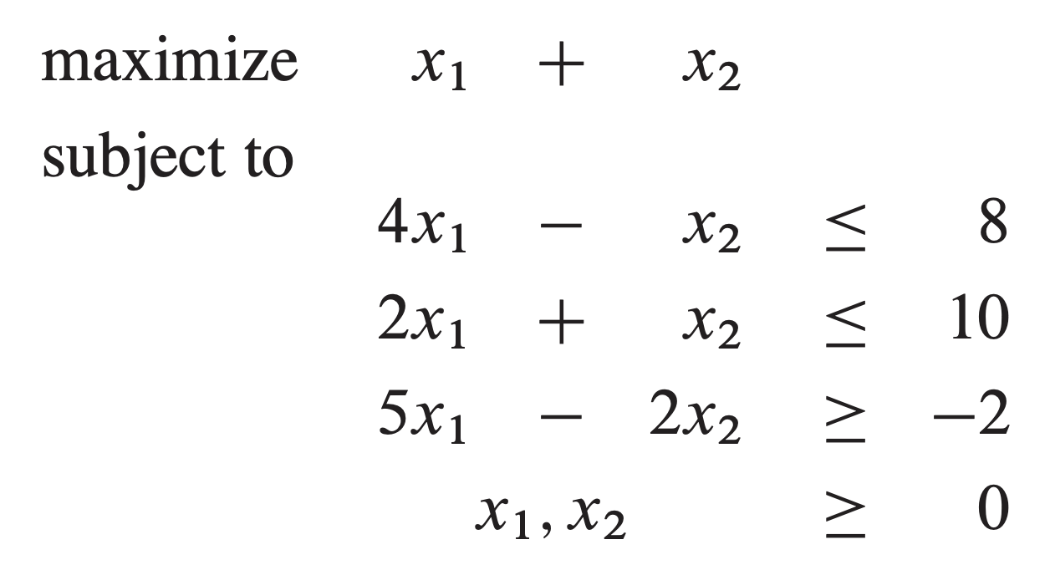
Linear Programming
As seen on the previous slide. A Linear Program is any problem in which you wish to maximize or minimize a linear function subject to a list of linear inequalities.
Most LPs have many (often infinite) feasible solutions.
Some LPs do not have a feasible solution
Others are unbounded (solution is infinite)

Slide 9
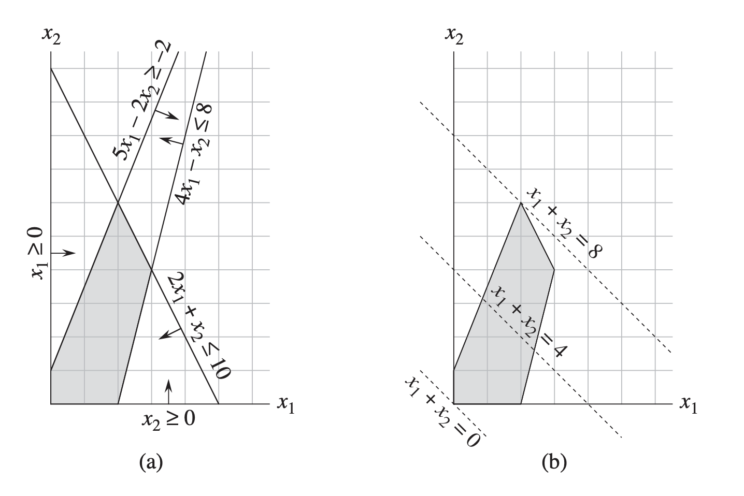
Linear Programming

Slide 10
Overall LP Process
Model your problem using linear functions
Put LP into proper format.
*Standard Form *Slack Form
Known Linear Programming Algorithms.
*Simplex *Ellipsoid Method *Interior Point Methods
Optimal Solution IFF one exists
Some algorithms require LP to be in a specific format
We will study Simplex Algorithm, but usually you will use these as black boxes
Usually this is the hardest part

Slide 11
Other Applications of LP
An airline wishes to schedule flight crews. The government imposes many constraints (such as number of consecutive flights worked), work hours per week, etc. Company wants to use as few employees as possible.
An oil company want to find new places to drill. They know the likelihood of a drill site paying off, the expected payout, how much it would cost to drill at each location, etc. They want to maximize profit.
**LP is a very general technique. If you can model your problem as a linear optimization under a set of linear constraints, you can use these algorithms!

Slide 12
Standard Form

Slide 13
Motivation for standard / Slack Form
It is easier to reason about Linear Programs if we have a standard format that all are required to be expressed in!
We will use a form called Standard Form for normalizing all Linear Programs.
Many algorithms either require the LP to be in standard form OR will convert it into standard form
Slack Form is another popular LP form that many algorithms use (Simplex uses it)

Slide 14
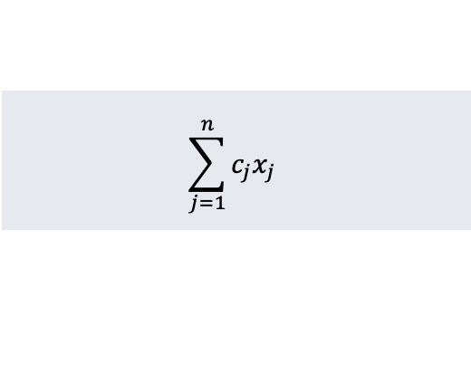
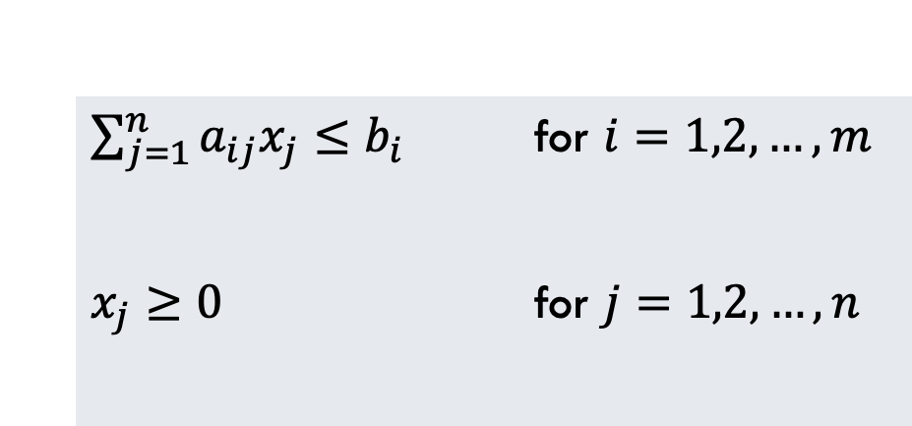
General Standard Form
In Standard From, we always maximize, all constraints are upper bound inequalities, and all variables have non-negativity constraints
$$\sum_{j=1}^{n}{c_{j}x_{j}}$$
Maximize:
Subject To:
$\sum_{j=1}^{n}{a_{ij}x_{j}≤b_{i}}$ for $i=1,2,…,m$
$x_{j}≥0$ for $j=1,2,…,n$

Slide 15
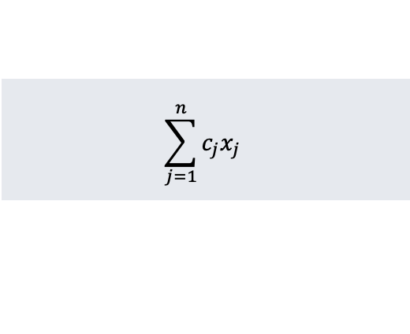
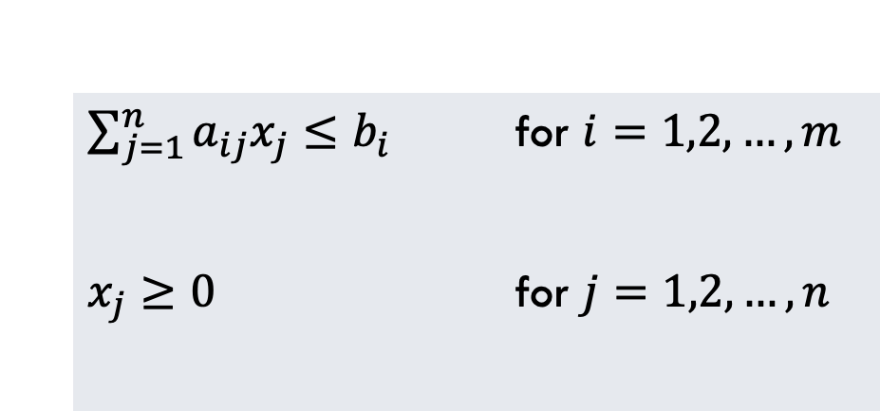



Standard Form (Matrix Representation)
Standard Form is usually expressed with matrices, making them easy to manipulate and work with.
c is coefficients of objective function. e.g.,:
$$c=\left(\begin{matrix}3 \\ 1 \\ 2\end{matrix}\right)$$
$$\sum_{j=1}^{n}{c_{j}x_{j}}$$
Maximize:
b is matrix of constant bounds. e.g.,:
$$b=\left(\begin{matrix}30 \\ 24 \\ 36\end{matrix}\right)$$
Subject To:
$\sum_{j=1}^{n}{a_{ij}x_{j}≤b_{i}}$ for $i=1,2,…,m$
$x_{j}≥0$ for $j=1,2,…,n$
A is coefficients all constraints. e.g.,:
$$A=\left(\begin{matrix}1 & 1 & 3 \\ 2 & 2 & 5 \\ 4 & 1 & 2\end{matrix}\right)$$
Thus, a Linear Program can be easily expressed in standard form using only the tuple of matrices {A, b, c}

Slide 16

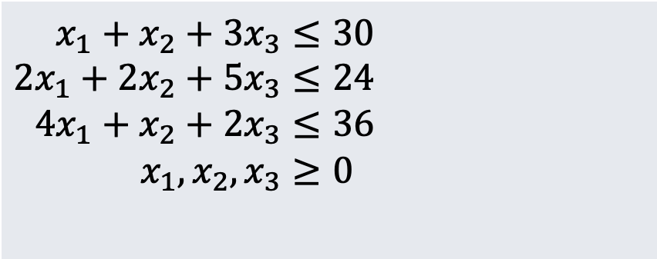
Standard Form (Matrix Representation)
Standard Form concrete example can be seen below.
c is coefficients of objective function. e.g.,:
$$c=\left(\begin{matrix}3 \\ 1 \\ 2\end{matrix}\right)$$
Maximize:
$$3x_{1}+x_{2}+2x_{3}$$
b is matrix of constant bounds. e.g.,:
$$b=\left(\begin{matrix}30 \\ 24 \\ 36\end{matrix}\right)$$
Subject To:
$$x_{1}+x_{2}+3x_{3}≤30 \\ 2x_{1}+2x_{2}+5x_{3}≤24 \\ 4x_{1}+x_{2}+2x_{3}≤36 \\ x_{1}, x_{2}, x_{3}≥0$$
A is coefficients all constraints. e.g.,:
$$A=\left(\begin{matrix}1 & 1 & 3 \\ 2 & 2 & 5 \\ 4 & 1 & 2\end{matrix}\right)$$

Slide 17
Some Terminology
Some definitions regarding solutions to Linear Programs:
Feasible Solution:
An assignment of the variables x_{i} that does NOT violate any of the constraints
Infeasible Solution:
An assignment of the variables x_{i} that DOES violate at least one of the constraints
Objective Value:
The value of the objective function given by some feasible solution
Optimal Solution:
The highest objective value that can be obtained by any feasible solution
Feasibility of LP:
If LP has no feasible solutions, it is infeasible, otherwise it is feasible
Unbounded:
If a Linear Program has an infinite optimal solution, then it is unbounded

Slide 18
Converting Linear Programs to Standard Form
There are four issues we might need to contend with when converting to Standard Form:
1.
Objective function minimizes instead of maximizes
2.
Some variables do not have a non-negativity constraint
3.
Some constraints might be equalities, instead of inequalities
4.
Some inequalities might be lower-bounds instead of upper-bounds

Slide 19
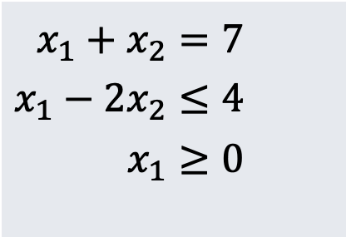
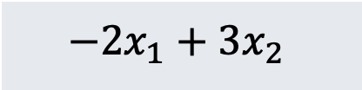
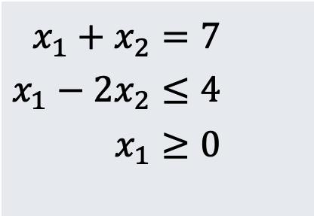
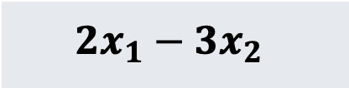
Issue 1: Objective Function Minimizes
Solution: Negative the coefficients of the objective function
Minimize:
$$−2x_{1}+3x_{2}$$
Maximize:
$$2x_{1}−3x_{2}$$
$$x_{1}+x_{2}=7 \\ x_{1}−2x_{2}≤4 \\ x_{1}≥0$$
$$x_{1}+x_{2}=7 \\ x_{1}−2x_{2}≤4 \\ x_{1}≥0$$

Slide 20
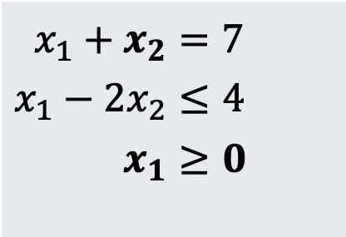
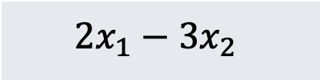
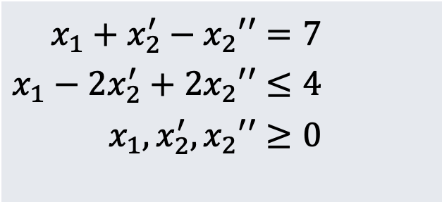

Issue 2: Vars without Non-Negativity
Solution: Introduce two new variables and their difference to each constraint
Maximize:
$$2x_{1}−3x_{2}$$
Maximize:
$$2x_{1}−3x_{2}^{′}+3x_{2}′′$$
$$x_{1}+x_{2}=7 \\ x_{1}−2x_{2}≤4 \\ x_{1}≥0$$
$$x_{1}+x_{2}^{′}−x_{2}′′=7 \\ x_{1}−2x_{2}^{′}+2x_{2}′′≤4 \\ x_{1},x_{2}^{′},x_{2}′′≥0$$
We introduce new variables x₂’ and x₂’’
Replace x₂ with expression (x₂’ – x₂’’) and simplify

Slide 21
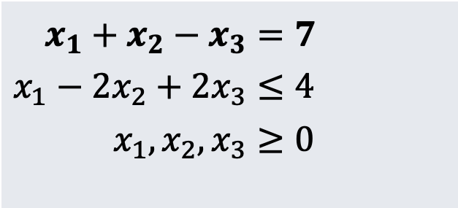

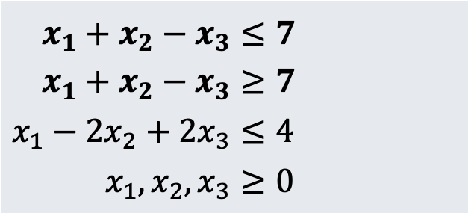

Issue 3: Equality Constraints
Solution: Separate into two inequality constraints instead (one of them will be fixed with issue 4 on the next slide)
Maximize:
$$2x_{1}−3x_{2}+3x_{3}$$
Maximize:
$$2x_{1}−3x_{2}+3x_{3}$$
$$x_{1}+x_{2}−x_{3}=7 \\ x_{1}−2x_{2}+2x_{3}≤4 \\ x_{1},x_{2},x_{3}≥0$$
$$x_{1}+x_{2}−x_{3}≤7 \\ x_{1}+x_{2}−x_{3}≥7 \\ x_{1}−2x_{2}+2x_{3}≤4 \\ x_{1},x_{2},x_{3}≥0$$
Notice we have renamed x₂’ to x₂ and x₂’’ to x₃ here

Slide 22

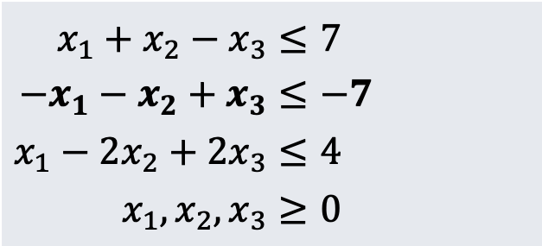
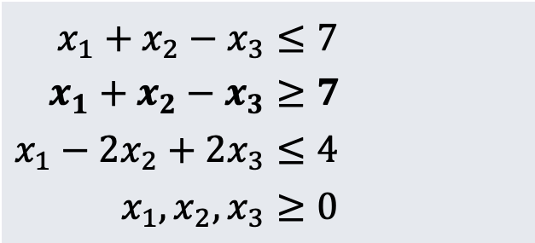
Issue 4: Inequality Constraints ($≥$)
Solution: Multiply through by -1 to reverse the inequality sign
Maximize:
$$2x_{1}−3x_{2}+3x_{3}$$
Maximize:
$$2x_{1}−3x_{2}+3x_{3}$$
$$x_{1}+x_{2}−x_{3}≤7 \\ x_{1}+x_{2}−x_{3}≥7 \\ x_{1}−2x_{2}+2x_{3}≤4 \\ x_{1},x_{2},x_{3}≥0$$
$$x_{1}+x_{2}−x_{3}≤7 \\ {−x}_{1}−x_{2}+x_{3}≤−7 \\ x_{1}−2x_{2}+2x_{3}≤4 \\ x_{1},x_{2},x_{3}≥0$$
This Linear Program is now in valid Standard Form

Slide 23
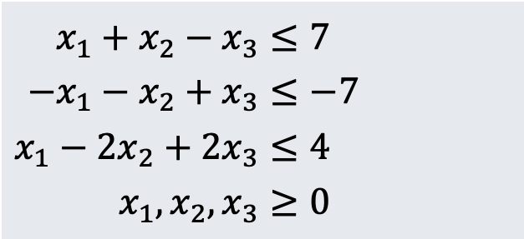

Conclusion
Standard Form gives a regular articulation of Linear Programs, and generic LPs can be converted into standard form. Can be represented easily with arrays.
Maximize:
$$2x_{1}−3x_{2}+3x_{3}$$
$$x_{1}+x_{2}−x_{3}≤7 \\ {−x}_{1}−x_{2}+x_{3}≤−7 \\ x_{1}−2x_{2}+2x_{3}≤4 \\ x_{1},x_{2},x_{3}≥0$$

Slide 24
Slack Form

Slide 25
Why Slack Form?
Some algorithms (like Simplex) operate in slack form only.
Very easy to convert between standard form and slack form.
Introduces new variables (basic and non-basic) which can be swapped and manipulated as the algorithm executes.

Slide 26
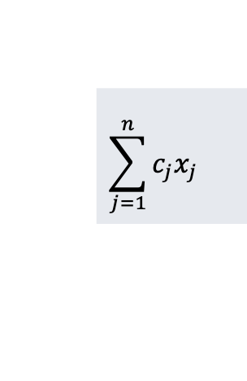
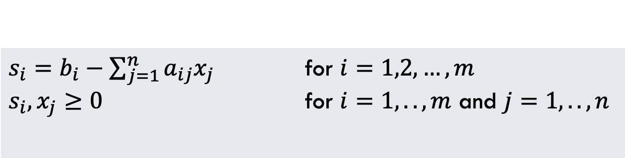
General Slack Form
In Slack Form, every constraint is in equality that models the slack (or difference) in the target constant and the variable terms.
$$\sum_{j=1}^{n}{c_{j}x_{j}}$$
Same as in Standard Form
Maximize:
Subject To:
$s_{i}=b_{i}−\sum_{j=1}^{n}{a_{ij}x_{j}}$ for $i=1,2,…,m$ $s_{i},x_{j}≥0$ for $i=1,..,m$ and $j=1,..,n$
Introduce new variable s_{i} for each constraint and model difference between left and right side of standard form constraint

Slide 27
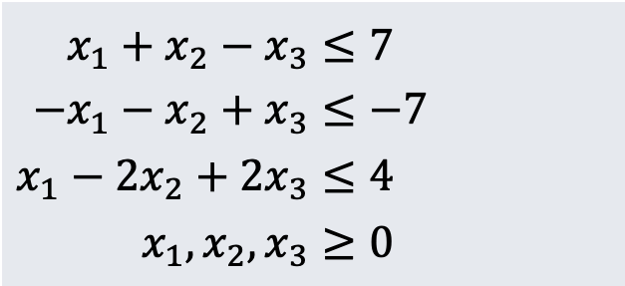

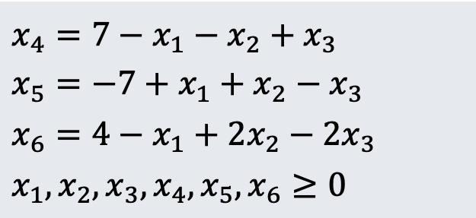

Example: Standard vs Slack
In Slack Form, every constraint is in equality that models the slack (or difference) in the target constant and the variable terms.
Standard Form:
Slack Form:
Maximize:
$$2x_{1}−3x_{2}+3x_{3}$$
Maximize:
$$0+2x_{1}−3x_{2}+3x_{3}$$
$$x_{1}+x_{2}−x_{3}≤7 \\ {−x}_{1}−x_{2}+x_{3}≤−7 \\ x_{1}−2x_{2}+2x_{3}≤4 \\ x_{1},x_{2},x_{3}≥0$$
$$x_{4}=7−x_{1}−x_{2}+x_{3} \\ {x_{5}=−7+x}_{1}+x_{2}−x_{3} \\ {x_{6}=4−x}_{1}+2x_{2}−2x_{3} \\ x_{1},x_{2},x_{3},x_{4},x_{5},x_{6}≥0$$

Slide 28

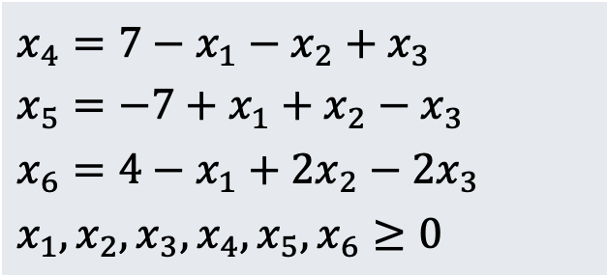





Representation of Slack Form
In Slack Form, we also use matrices to represent coefficients.
c is coefficients of objective function:
$$c=\left(\begin{matrix}2 \\ −3 \\ 3\end{matrix}\right)$$
Maximize:
v is constant term of objective function (here v=0)
$$0+2x_{1}−3x_{2}+3x_{3}$$
$$x_{4}=7−x_{1}−x_{2}+x_{3} \\ {x_{5}=−7+x}_{1}+x_{2}−x_{3} \\ {x_{6}=4−x}_{1}+2x_{2}−2x_{3} \\ x_{1},x_{2},x_{3},x_{4},x_{5},x_{6}≥0$$
b is constant terms of constraints:
$$b=\left(\begin{matrix}7 \\ −7 \\ 4\end{matrix}\right)$$
Basic Variables:
$$B=\{x_{4},x_{5},x_{6}\}$$
A is coefficients of non-basic variables in constraints:
$$A=\left(\begin{matrix}1 & 1 & −1 \\ −1 & −1 & 1 \\ 1 & −1 & 2\end{matrix}\right)$$
Non-basic Variables:
N$=\{x_{1},x_{2},x_{3}\}$
So, our slack form can be represented with these five variables:
N, B, A, b, c, v

Slide 29
Using Linear programming to solve Shortest Path problem

Slide 30
Recall: shortest path problems
Shortest path problems ask you to find the shortest weighted path from a start node to some designated destination node in a weighted graph.

Slide 31
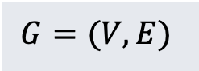

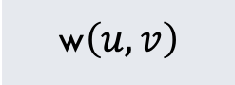
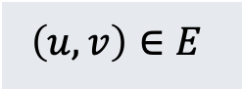
Some terms
$$d_{u}$$
The shortest weighted distance from the start node to an arbitrary node u
$$G=(V,E)$$
Definition of a graph
$$\left(u,v\right)∈E$$
Definition of an Edge. Note u,v are in V
w$\left(u,v\right)$
Weight of an edge from u to v

Slide 32
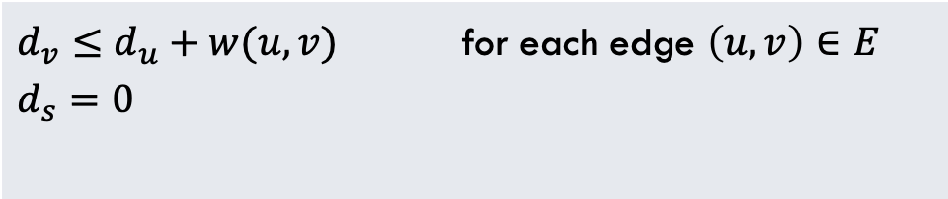
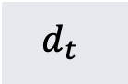
Shortest path: LP Solution
Maximize? Why? I thought this was shortest path?
Maximize:
$$d_{t}$$
Subject to:
$d_{v}≤d_{u}+w(u,v)$ for each edge $\left(u,v\right)∈E$
$$d_{s}=0$$
No distance can be greater than all the valid ways to get to this node
Distance to start node MUST be 0

Slide 33
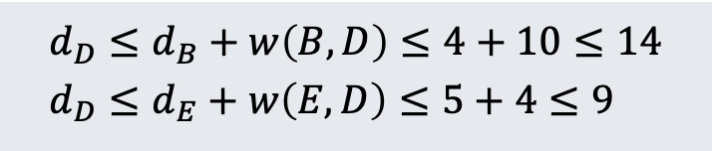
Why Maximize?
Consider shortest path to node D in the graph here. Two ways:
- Go through node B - Go Through node E
Feasible range of answers. 0 through 9 are less than or equal to EVERY unique path to D
9 is the largest feasible answer, and the only feasible answer that is actually a correct distance to node D
$$d_{D}≤d_{B}+w\left(B,D\right)≤4+10≤14 \\ d_{D}≤d_{E}+w\left(E,D\right)≤5+4≤9$$
All values above 9 are not feasible AND not the correct shortest distance to D
0
9
14

Slide 34
Using Linear programming to solve Max-Flow Problem

Slide 35
Recall: Maximum Flow
Maximum Flow asks you to find the most units of flow that can be pushed from source node to a sink node in a flow network (see example below).

Slide 36

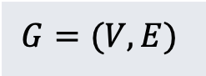
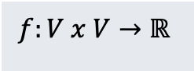
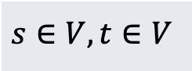
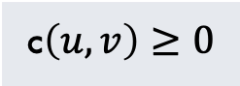
Some terms
$$G=(V,E)$$
Definition of a graph
$$\left(u,v\right)∈E$$
Definition of an Edge. Note u,v are in V
c$\left(u,v\right)≥0$
Capacity of each edge. Cannot be negative
$$s∈V, t∈V$$
One special source and sink node
$$f:V x V→ℝ$$
A valid flow is an assignment of flow values on each pair of vertices satisfying certain constraints (flow conservation etc.)

Slide 37
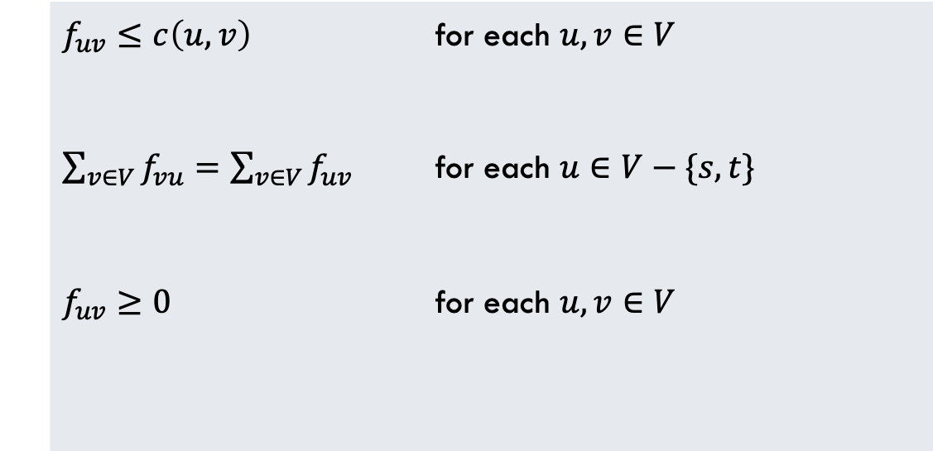
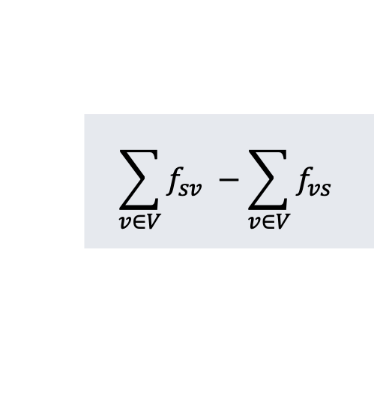
Max-Flow: LP Solution
Want to maximize the flow coming out of the source node
$$\sum_{v∈V}{f_{sv} −\sum_{v∈V}{f_{vs}}}$$
Maximize:
Ensure that flow through every edge does not exceed capacity of that edge.
Subject to:
$f_{uv}≤c\left(u,v\right)$ for each $u,v∈V$
$\sum_{v∈V}{f_{vu}=\sum_{v∈V}{f_{uv}}}$ for each $u∈V−\{s,t\}$
$f_{uv}≥0$ for each $u,v∈V$
Flow conservation: Flow entering each node must equal flow leaving that node.
All flow values must be non-negative

Slide 38
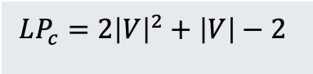
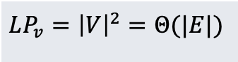
Size of the Linear Program
We should always analyze the size of our Linear Programs. Let’s use two metrics:
- Number of variables in the linear program
- Number of constraint equations in the linear program
$$LP_{v}={\left|V\right|}^{2}=Θ(|E|)$$
Number of variables is linear in number of edges of graph, quadratic in number of nodes in graph.
$$LP_{c}=2{\left|V\right|}^{2}+\left|V\right|−2$$
Number of constraints.
**So, this linear program is considered polynomial in size relative to the size of the flow graph.

Slide 39
Min-Cost Flow

Slide 40
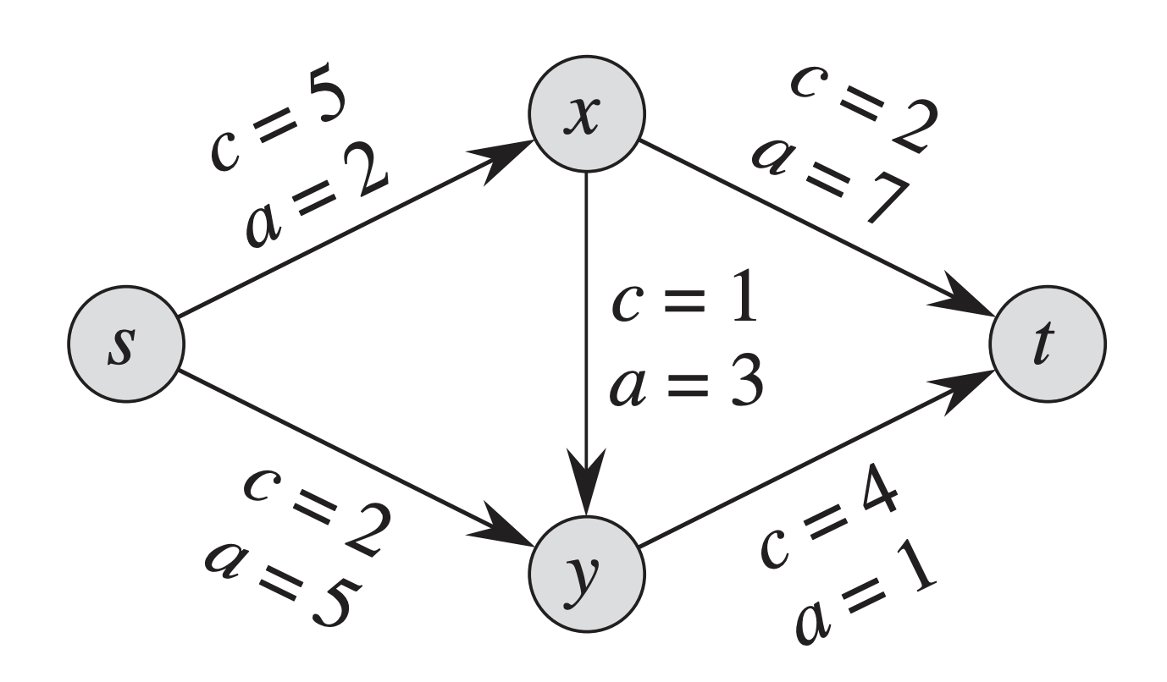
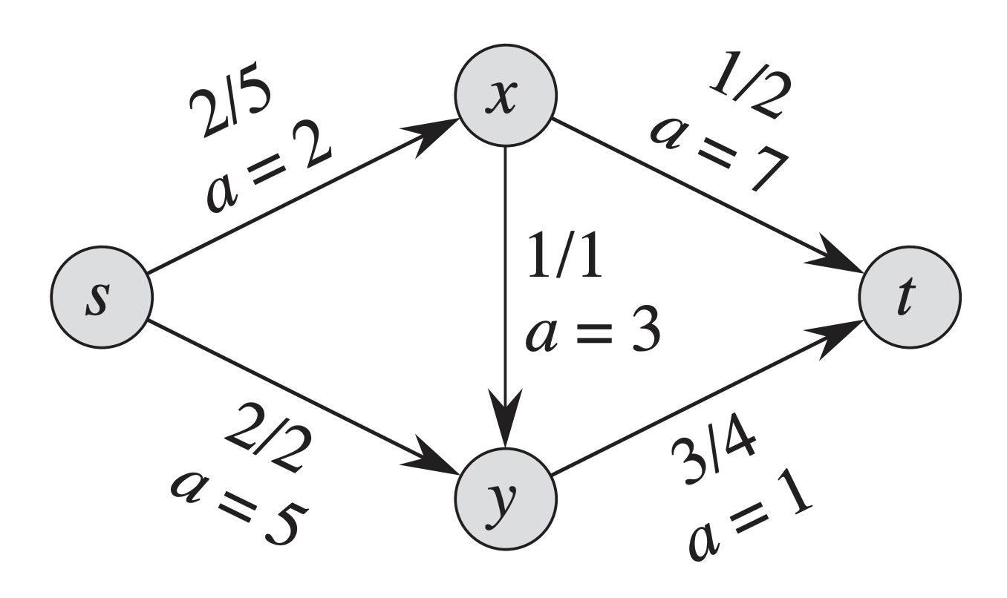

Minimum-Cost Flow
Similar to the Max-Flow Problem, the Min-Cost Flow problem provides a flow-network, an integer d, and a cost function a(u,v)
d = 4
d = 4
An example min-cost flow network. We want to push d=4 units of flow through the network. the ‘a’ values are the costs
Solution to the network. We incur cost:
$$2\left(2\right)+2\left(5\right)+1\left(7\right)+3\left(1\right)= \\ 4+10+7+3=24$$

Slide 41

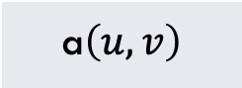

Some terms
$$G=(V,E)$$
Definition of a graph
$$\left(u,v\right)∈E$$
Definition of an Edge. Note u,v are in V
c$\left(u,v\right)≥0$
Capacity of each edge. Cannot be negative
a$\left(u,v\right)$
Cost per unit of flow on edge from u to v
$$s∈V, t∈V$$
One special source and sink node
$$f:V x V→ℝ$$
A valid flow is an assignment of flow values on each pair of vertices satisfying certain constraints (flow conservation etc.)

Slide 42
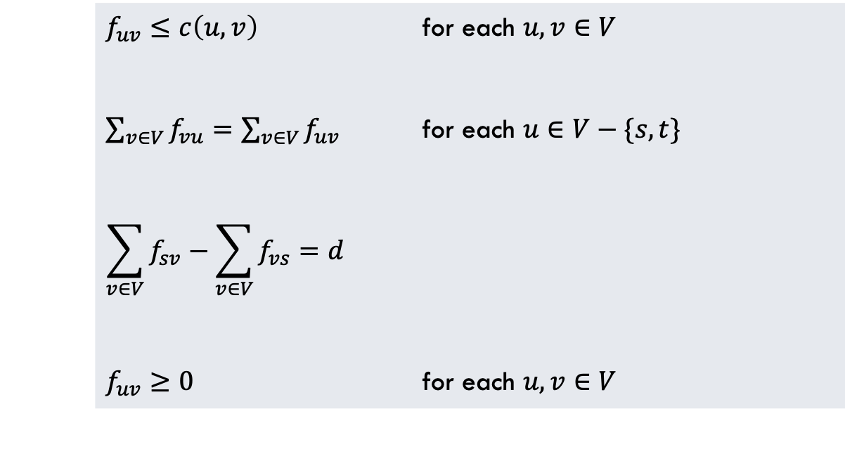
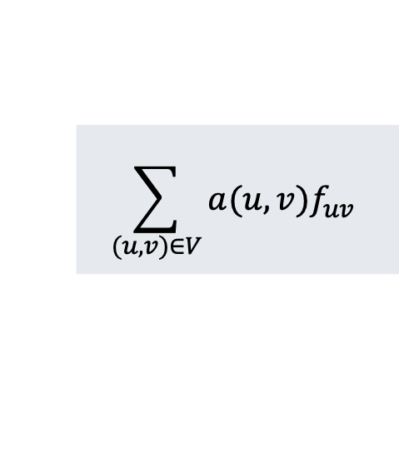
Min-Cost Flow: LP Solution
Want to minimize the cost of the flow moving along all the edges in the Graph
$$\sum_{(u,v)∈V}{{a(u,v)f}_{uv}}$$
Minimize:
Ensure that flow through every edge does not exceed capacity of that edge.
Flow conservation: Flow entering each node must equal flow leaving that node.
Subject to:
$f_{uv}≤c\left(u,v\right)$ for each $u,v∈V$
$\sum_{v∈V}{f_{vu}=\sum_{v∈V}{f_{uv}}}$ for each $u∈V−\{s,t\}$
$$\sum_{v∈V}{f_{sv}−\sum_{v∈V}{f_{vs}}}=d$$
$f_{uv}≥0$ for each $u,v∈V$
Flow must be exactly equal to d
All flow values must be non-negative

Slide 43
The Simplex Algorithm

Slide 44
Simplex Algorithm Overview
Simplex Algorithm: The main idea is to iteratively increase a variable as much as possible, then re-arrange the linear program so that you can do this again. Algorithm Overview:
| Convert the Linear Program to Slack Form (if not already) | Calculate the Basic Solution to the Linear Program and see if it is feasible | If the Basic Solution is NOT feasible |---| Use a Pivot to convert the LP into a form in which basic solution is feasible | Loop until ALL coefficients of objective function are negative |---|Find a variable x_{e} with coefficient in objective function that is non-negative |---|Find constraint with basic variable x_{l} that most limits how much we can increase x_{e} |---|Use a call to Pivot to switch the roles of x_{e} and x_{l}
Several things we need to work out: What is a basic solution? A basic feasible solution? What is the Pivot operation? How do we choose x_{e} and x_{l}?

Slide 45

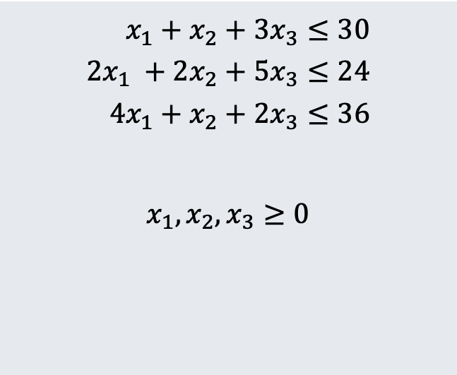
Simplex Algorithm Example
Maximize:
$$3x_{1}+x_{2}+2x_{3}$$
Subject To:
$$x_{1}+x_{2}+3x_{3}≤30 \\ 2x_{1} +2x_{2}+5x_{3}≤24 \\ 4x_{1}+x_{2}+2x_{3}≤36$$ $$x_{1},x_{2},x_{3}≥0$$

Slide 46

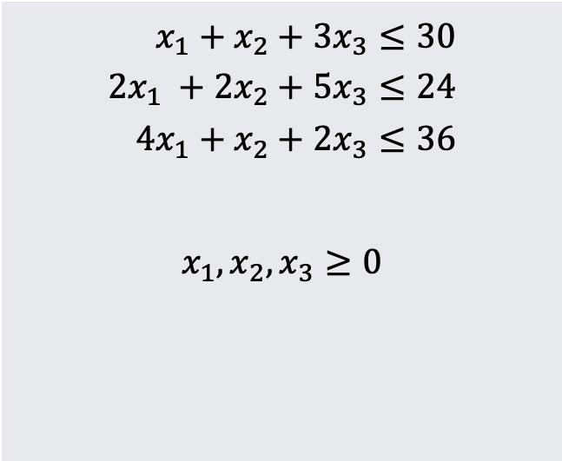

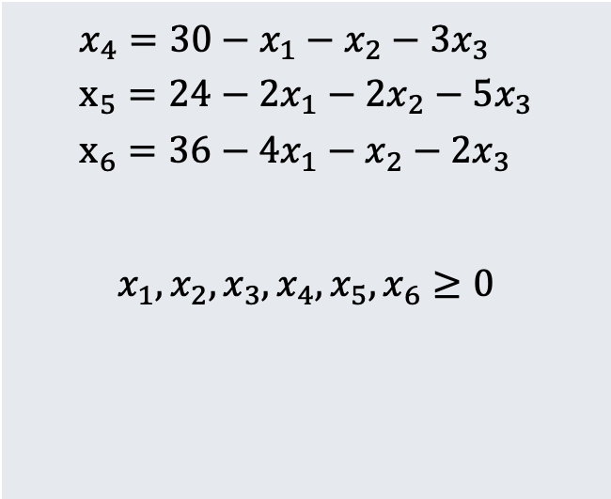
Simplex Algorithm Example
Step 1: Convert Linear Program to Slack Form
Maximize:
$$3x_{1}+x_{2}+2x_{3}$$
$$z=3x_{1}+x_{2}+2x_{3}$$
Subject To:
$$x_{1}+x_{2}+3x_{3}≤30 \\ 2x_{1} +2x_{2}+5x_{3}≤24 \\ 4x_{1}+x_{2}+2x_{3}≤36$$ $$x_{1},x_{2},x_{3}≥0$$
$${x_{4}=30−x}_{1}−x_{2}−3x_{3} \\ x_{5}=24−2x_{1}−2x_{2}−5x_{3} \\ x_{6}=36−4x_{1}−x_{2}−2x_{3}$$ $$x_{1},x_{2},x_{3},x_{4},x_{5},x_{6}≥0$$

Slide 47



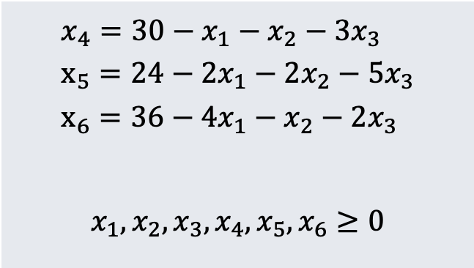

Simplex Algorithm Example
Step 1.a: Recall how Slack Forms are represented as matrices
c is coefficients of objective function:
$$c=\left(\begin{matrix}3 \\ 1 \\ 2\end{matrix}\right)$$
v is constant term of objective function (here v=0)
$$z=0+3x_{1}+x_{2}+2x_{3}$$
$${x_{4}=30−x}_{1}−x_{2}−3x_{3} \\ x_{5}=24−2x_{1}−2x_{2}−5x_{3} \\ x_{6}=36−4x_{1}−x_{2}−2x_{3}$$ $$x_{1},x_{2},x_{3},x_{4},x_{5},x_{6}≥0$$
b is constant terms of constraints:
$$b=\left(\begin{matrix}30 \\ 24 \\ 36\end{matrix}\right)$$
Basic Variables:
$$B=\{x_{4},x_{5},x_{6}\}$$
A is coefficients of non-basic variables in constraints:
$$A=\left(\begin{matrix}1 & 1 & 3 \\ 2 & 2 & 5 \\ 4 & 1 & 2\end{matrix}\right)$$
Non-basic Variables:
N$=\{x_{1},x_{2},x_{3}\}$
So, our implementation will use these variables when executing:
N, B, A, b, c, v

Slide 48

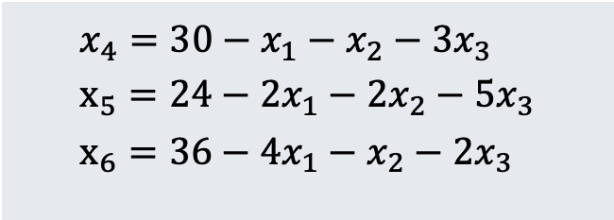
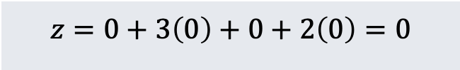


Simplex Algorithm Example
Step 2: Define / Find the Basic Solution and Basic Feasible Solution
$$z=0+3x_{1}+x_{2}+2x_{3}$$
Basic Solution: The solution in which all of the basic variables (here, $B=\{x_{1},x_{2},x_{3}\}$) are set to 0.
The Basic Solution is a Basic Feasible Solution if it is feasible (i.e., does NOT violate any constraints).
$${x_{4}=30−x}_{1}−x_{2}−3x_{3} \\ x_{5}=24−2x_{1}−2x_{2}−5x_{3} \\ x_{6}=36−4x_{1}−x_{2}−2x_{3}$$
$$z=0+3\left(0\right)+0+2\left(0\right)=0$$
**Here, the basic solution is indeed feasible because all variables are still positive. Objective function is 0 (which is not good…yet)
$$x_{4}=30−0−0−3\left(0\right)=30 \\ x_{5}=24−2\left(0\right)−2\left(0\right)−5\left(0\right)=24 \\ x_{6}=36−4\left(0\right)−0−2\left(0\right)=36$$

Slide 49
Simplex Algorithm Example
Step 2.a: What do we do if the basic solution is NOT feasible
We do have a method for finding a slack form that HAS a basic feasible solution from any arbitrary Linear Program in Standard Form. So, let’s let this method do the conversion to slack form for us AND have it guarantee that the basic solution is feasible
LP in Slack Form w/ Basic Feasible Solution (N, B, A, b, c, v)
Linear Program in Standard Form:
(A, b, c)
**We will look at how this works later on
INITIALIZE-SIMPLEX(A, b, c)
“Infeasible”

Slide 50


Simplex Algorithm Example
Step 3: Choose a non-basic variable and increase it as much as possible
$$z=0+3x_{1}+x_{2}+2x_{3}$$
Increasing any of these variables will increase the objective function. Let’s choose x₁ for now.
$${x_{4}=30−x}_{1}−x_{2}−3x_{3} \\ x_{5}=24−2x_{1}−2x_{2}−5x_{3} \\ x_{6}=36−4x_{1}−x_{2}−2x_{3}$$
As we increase x₁, all of these basic variables will decrease (and cannot go below 0). So…how much can we increase x₁?

Slide 51

Simplex Algorithm Example
Step 3.a: Start swapping a basic and non-basic variable
$$z=0+3x_{1}+x_{2}+2x_{3}$$
We can increase x₁ by 30, 12, and 9 respectively.
Thus, the third constraint (x₆) is the tightest constraint, and so 9 is the most we can increase x₁
$${x_{4}=30−x}_{1}−x_{2}−3x_{3} \\ x_{5}=24−2x_{1}−2x_{2}−5x_{3} \\ x_{6}=36−4x_{1}−x_{2}−2x_{3}$$
$$x_{6}=36−4x_{1}−x_{2}−2x_{3} \\ 4x_{1}=36−x_{2}−2x_{3}−x_{6} \\ x_{1}=9−\frac{x_{2}}{4}−\frac{x_{3}}{2}−\frac{x_{6}}{4}$$
So, we want to switch x1 and x6 (make x1 basic and x6 non-basic). To do this, solve the third constraint for x1 first.

Slide 52


Simplex Algorithm Example
Step 3.b: Complete the swap
$$x_{6}=36−4x_{1}−x_{2}−2x_{3} \\ 4x_{1}=36−x_{2}−2x_{3}−x_{6} \\ x_{1}=9−\frac{x_{2}}{4}−\frac{x_{3}}{2}−\frac{x_{6}}{4}$$
$$x_{4}=30−x_{1}−x_{2}−3x_{3} \\ =30−\left(9−\frac{x_{2}}{4}−\frac{x_{3}}{2}−\frac{x_{6}}{4}\right)−x_{2}−3x_{3} \\ =21−\frac{3x_{2}}{4}−\frac{5x_{3}}{2}+\frac{x_{6}}{4}$$
To remove x₁ as a non-basic variable from ALL other equations (including objective function), substitute this new equation for x₁ in all others and simplify them.
Example: Substituting and simplifying for equation x₄

Slide 53


Simplex Algorithm Example
Step 3.c: Do this for EVERY equation (objective and all constraints) to get new Linear Program
$$z=27+\frac{x_{2}}{4}+\frac{x_{3}}{2}−\frac{3x_{6}}{4}$$
$$x_{1}=9−\frac{x_{2}}{4}−\frac{x_{3}}{2}−\frac{x_{6}}{4} \\ x_{4}=21−\frac{3x_{2}}{4}−\frac{5x_{3}}{2}+\frac{x_{6}}{4} \\ x_{5}=6−\frac{3x_{2}}{2}+4x_{3}+\frac{x_{6}}{2}$$
Note several things: x₁ is now a basic variable and x₆ is now a non-basic variable The basic feasible solution now has objective value 27 (as expected if x₁ = 9 in original LP) This process (of swapping x₁ and x₆) is called a PIVOT

Slide 54

Generalizing the Pivot Method
Here is the general approach for the Pivot Operation
l is the leaving variable (e.g., x₆) and e is the entering variable (e.g., x₁)
**Note: Returns new slack form AFTER pivot is complete

Slide 55


Simplex Algorithm Example
Step 4: Finish our example by increasing another basic variable
$$z=27+\frac{x_{2}}{4}+\frac{x_{3}}{2}−\frac{3x_{6}}{4}$$
Don’t choose x₆, this decreases the objective value. Let’s choose x₃
$$x_{1}=9−\frac{x_{2}}{4}−\frac{x_{3}}{2}−\frac{x_{6}}{4} \\ x_{4}=21−\frac{3x_{2}}{4}−\frac{5x_{3}}{2}+\frac{x_{6}}{4} \\ x_{5}=6−\frac{3x_{2}}{2}+4x_{3}+\frac{x_{6}}{2}$$
Which function constrains how much we can increase x₃ the most?
We can increase x₃ by 18, 42/5, and 3/2 respectively.
So…again the third constraint is the tightest one

Slide 56


Simplex Algorithm Example
Step 4: Finish our example by increasing another basic variable
$$z=27+\frac{x_{2}}{4}+\frac{x_{3}}{2}−\frac{3x_{6}}{4}$$
So, x3 will be the entering variable and x5 will be the exiting variable.
Process:
- Solve x₅ equation for x₃ and simplify - Substitute value of x₃ in each other equation and simplify
$$x_{1}=9−\frac{x_{2}}{4}−\frac{x_{3}}{2}−\frac{x_{6}}{4} \\ x_{4}=21−\frac{3x_{2}}{4}−\frac{5x_{3}}{2}+\frac{x_{6}}{4} \\ x_{5}=6−\frac{3x_{2}}{2}+4x_{3}+\frac{x_{6}}{2}$$

Slide 57


Simplex Algorithm Example
Step 4: Result of second pivot shown here (just trust me?)
$$z=\frac{111}{4}+\frac{x_{2}}{16}−\frac{x_{5}}{8}−\frac{11x_{6}}{16}$$
Objective value now 111/4
x₂ still has positive coefficient, so how much can we increase it by?
This time, we can increase x₂ by 4 at most (x₃ constraint is most tight)
$$x_{1}=\frac{33}{4}−\frac{x_{2}}{16}+\frac{x_{5}}{8}−\frac{5x_{6}}{16} \\ x_{3}=\frac{3}{2}−\frac{3x_{2}}{8}−\frac{x_{5}}{4}+\frac{x_{6}}{8} \\ x_{4}=\frac{69}{4}+\frac{3x_{2}}{16}+\frac{5x_{5}}{8}−\frac{x_{6}}{16}$$

Slide 58


Simplex Algorithm Example
Step 5: Last Pivot (x2 enters and x3 leaves)
All coefficients in objective function are negative, so cannot pivot again!
$$z=28−\frac{x_{3}}{6}−\frac{x_{5}}{6}−\frac{2x_{6}}{3}$$
Basic feasible solution IS the optimal solution at this point.
Objective value is 28
$$x_{1}=8+\frac{x_{3}}{6}+\frac{x_{5}}{6}−\frac{x_{6}}{3} \\ x_{2}=4−\frac{8x_{3}}{3}−\frac{2x_{5}}{3}+\frac{x_{6}}{3} \\ x_{4}=18−\frac{x_{3}}{2}+\frac{x_{5}}{2}$$

Slide 59

Simplex Algorithm Overview
Simplex Algorithm: The main idea is to iteratively increase a variable as much as possible, then re-arrange the linear program so that you can do this again. Algorithm Overview:

Slide 60

Notes about Simplex
Simplex is NOT guaranteed to terminate. LP could be degenerate, and cycle through a sequence of slack forms that all have the same objective value
There IS a way to check if you are in a cycle pretty simply (see book)
Simplex is USUALLY fast, but can sometimes be $Ω(n^{c})$
Other LP Algorithms are guaranteed to be polynomial time, but we won’t study them here

Slide 61
How Does Initialize-Simplex Work?

Slide 62
Initialize-Simplex Overview
Basic Idea:
| Given a linear program in which the basic solution is NOT feasible | Introduce a new variable x₀ and add –x₀ to each constraint | Make –x₀ the objective function as well | Call Pivot (x0 is entering variable, exiting variable is basic var that is MOST negative) | The resulting LP is guaranteed to have a basic feasible solution | Run Simplex loop to find optimal solution to this new LP | If the optimal solution to this new LP sets x₀ to 0 |---| if x0 is basic |------| Perform one pivot to make it non-basic |---| Remove x0 from the solution’s slack form (set to 0) and restore original obj. func. |---| Return new slack form | Else |---| Return “infeasible”

Slide 63


Initialize-Simplex Example
Consider the following LP. Note that basic solution is NOT feasible
$$z=2x_{1}−x_{2}$$
Basic solution sets x₁ and x₂ to 0
But in second equation, 0 is not less than or equal to -4
$$2x_{1}−x_{2}≤2 \\ x_{1}−5x_{2}≤−4 \\ x_{1},x_{2}≥0$$

Slide 64




Initialize-Simplex Example
Step 1: Introduce variable x₀
$$z=−x_{0}$$
Change objective function to –x₀
Add a term –x₀ to each constraint
$$2x_{1}−x_{2}−x_{0}≤2 \\ x_{1}−5x_{2}−x_{0}≤−4 \\ x_{1},x_{2, }x_{0}≥0$$
Equivalent slack form given by:
$$z=−x_{0}$$
$$x_{3}=2−2x_{1}+x_{2}+x_{0} \\ x_{4}=−4−x_{1}+5x_{2}+x_{0}$$

Slide 65


Initialize-Simplex Example
Lemma: The original Linear Program L is feasible if and only if this new Linear Program L_{aux} (shown below) has an optimal objective value of 0.
Equivalent slack form given by:
$$z=−x_{0}$$
$$x_{3}=2−2x_{1}+x_{2}+x_{0} \\ x_{4}=−4−x_{1}+5x_{2}+x_{0}$$
Why?
Suppose L has a feasible solution, then L_{aux} has a feasible solution setting x₀ to 0 (which eliminates all terms in L_{aux} except items already in L
Now suppose L_{aux} has a feasible solution, then x₀ must have been set to 0 and the remaining variable values must satisfy the original LP L

Slide 66

Initialize-Simplex Psuedo-Code
Initialize Simplex: Overview of the implementation of this initialization method

Slide 67
Conclusion

Slide 68
Conclusions
Linear Programming is a powerful technique for solving a wide range of problems.
To use, model your problem as a maximization / minimization problem and a set of linear constraints. You may need to convert to standard form or slack form.
Use a black box algorithm. We studied simplex, but many other exist that run in Polynomial Time.

